Slide 1
Reliability and Validity lesson5 hands on
By Skye Hillhouse

Slide 2
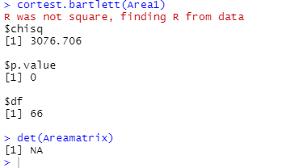

Whether this data is suitable for factor analysis
The determinate state NA this is not reasonable
The best model fit for this data
How the items group together into factors, if there is more than one factor indicated
Whether the scale is considered reliable through inter-rater reliability
Whether the scale is considered reliable through inter-item reliability

Slide 3
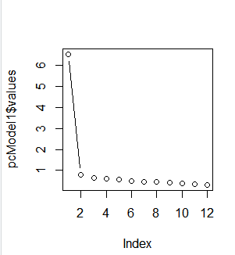
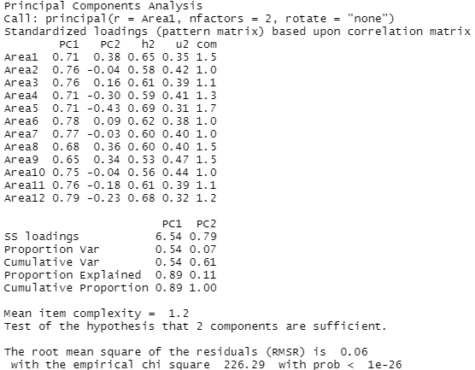
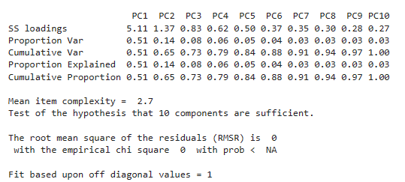
The appropriate number of factors for this data
.
> sum(largeResid)
[1] NA

Slide 4
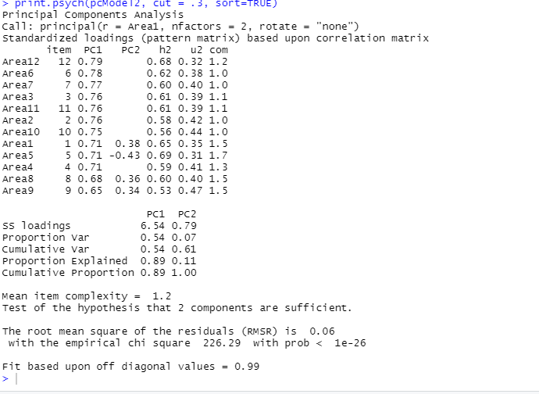
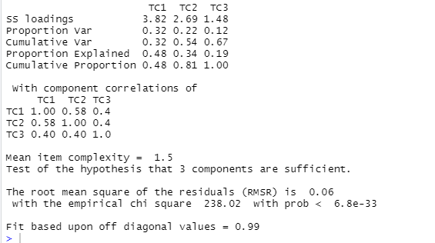
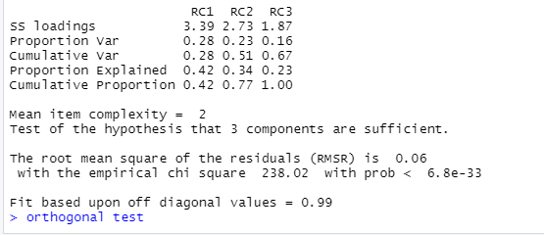
o
Oblique test
The best model fit for this data

Slide 5
Student1$Area1_3r <- NA
Student1$Area1_3r[Student1$Area1_3 == 1] <- 5
Student1$Area1_3r[Student1$Area1_3 == 2] <- 4
Student1$Area1_3r[Student1$Area1_3 == 3] <- 3
Student1$Area1_3r[Student1$Area1_3 == 4] <- 2
Student1$Area1_3r[Student1$Area1_3 == 5] <- 1
Student1$Area1_5r <- NA
Student1$Area1_5r[Student1$Area1_5 == 1] <- 5
Student1$Area1_5r[Student1$Area1_5 == 2] <- 4
Student1$Area1_5r[Student1$Area1_5 == 3] <- 3
Student1$Area1_5r[Student1$Area1_5 == 4] <- 2
Student1$Area1_5r[Student1$Area1_5 == 5] <- 1
Student1$Area1_6r <- NA
Student1$Area1_6r[Student1$Area1_6 == 1] <- 5
Student1$Area1_6r[Student1$Area1_6 == 2] <- 4
Student1$Area1_6r[Student1$Area1_6 == 3] <- 3
Student1$Area1_6r[Student1$Area1_6 == 4] <- 2
Student1$Area1_6r[Student1$Area1_6 == 5] <- 1
Student1$Area2_1r <- NA
Student1$Area2_1r[Student1$Area2_1 == 1] <- 5
Student1$Area2_1r[Student1$Area2_1 == 2] <- 4
Student1$Area2_1r[Student1$Area2_1 == 3] <- 3
Student1$Area2_1r[Student1$Area2_1 == 4] <- 2
Student1$Area2_1r[Student1$Area2_1 == 5] <- 1
Student1$Area2_3r <- NA
Student1$Area2_3r[Student1$Area2_3 == 1] <- 5
Student1$Area2_3r[Student1$Area2_3 == 2] <- 4
Student1$Area2_3r[Student1$Area2_3 == 3] <- 3
Student1$Area2_3r[Student1$Area2_3 == 4] <- 2
Student1$Area2_3r[Student1$Area2_3 == 5] <- 1
Student1$Area2_4r <- NA
Student1$Area2_4r[Student1$Area2_4 == 1] <- 5
Student1$Area2_4r[Student1$Area2_4 == 2] <- 4
Student1$Area2_4r[Student1$Area2_4 == 3] <- 3
Student1$Area2_4r[Student1$Area2_4 == 4] <- 2
Student1$Area2_4r[Student1$Area2_4 == 5] <- 1
Student2 <- Student1[, c(1,2,4,8,11,12,13,14,15,16)]
How the items group together into factors, if there is more than one factor indicated
alpha(goodArea)
alpha(badArea)
alpha(Student2)

Slide 6
Whether the scale is considered reliable through inter-rater reliability

Slide 7
Whether the scale is considered reliable through inter-item reliability

